Slide 1
Parallelization of K-Means Clustering
By:
Vedashree Shinde(20190802044)

Slide 2
1.
Introduction
K -means is the oldest and most popular clustering technique used, clustering techniques are the most important part of the data analysis.
To make it more stable and portable we have tried parallelization to itr.
K-means clustering algorithm with OpenMP is proposed in this paper.
OpenMP may be a set of compiler directives still as an API for programs written in C, C++, or FORTRAN that gives support for parallel programming in shared-memory environments

Slide 3
Parallelization:
In the simplest sense, Parallelization(parallel computing) is that the simultaneous use of multiple compute resources to resolve a computational problem

Slide 4
2.
Formulization

Slide 5
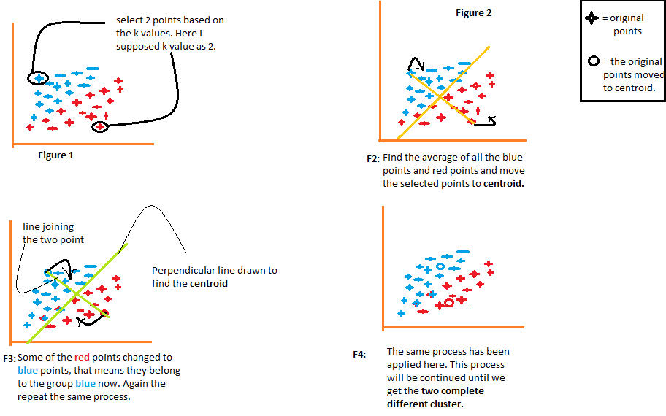
K-means clustering tries to group similar types of items within the style of clusters. It finds the similarity between the things and groups them into the clusters.
We will select the k values.
Initialize the centroids.
Select the group and find the average.

Slide 6
3. Implementation

Slide 7
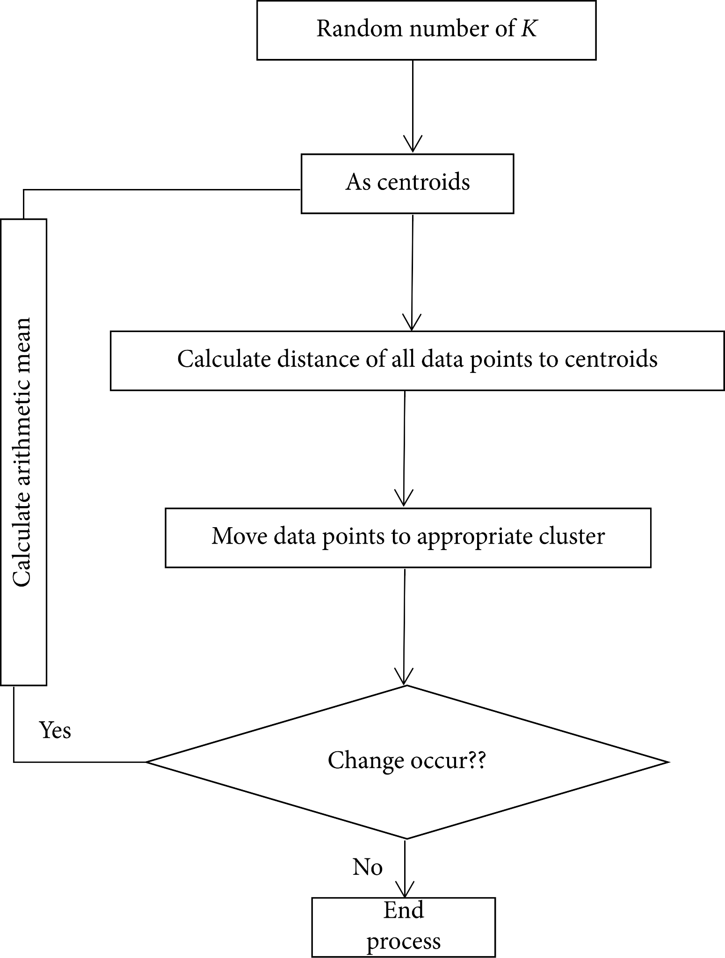
Flow chart of Simple K-Mean algorithm.

Slide 8
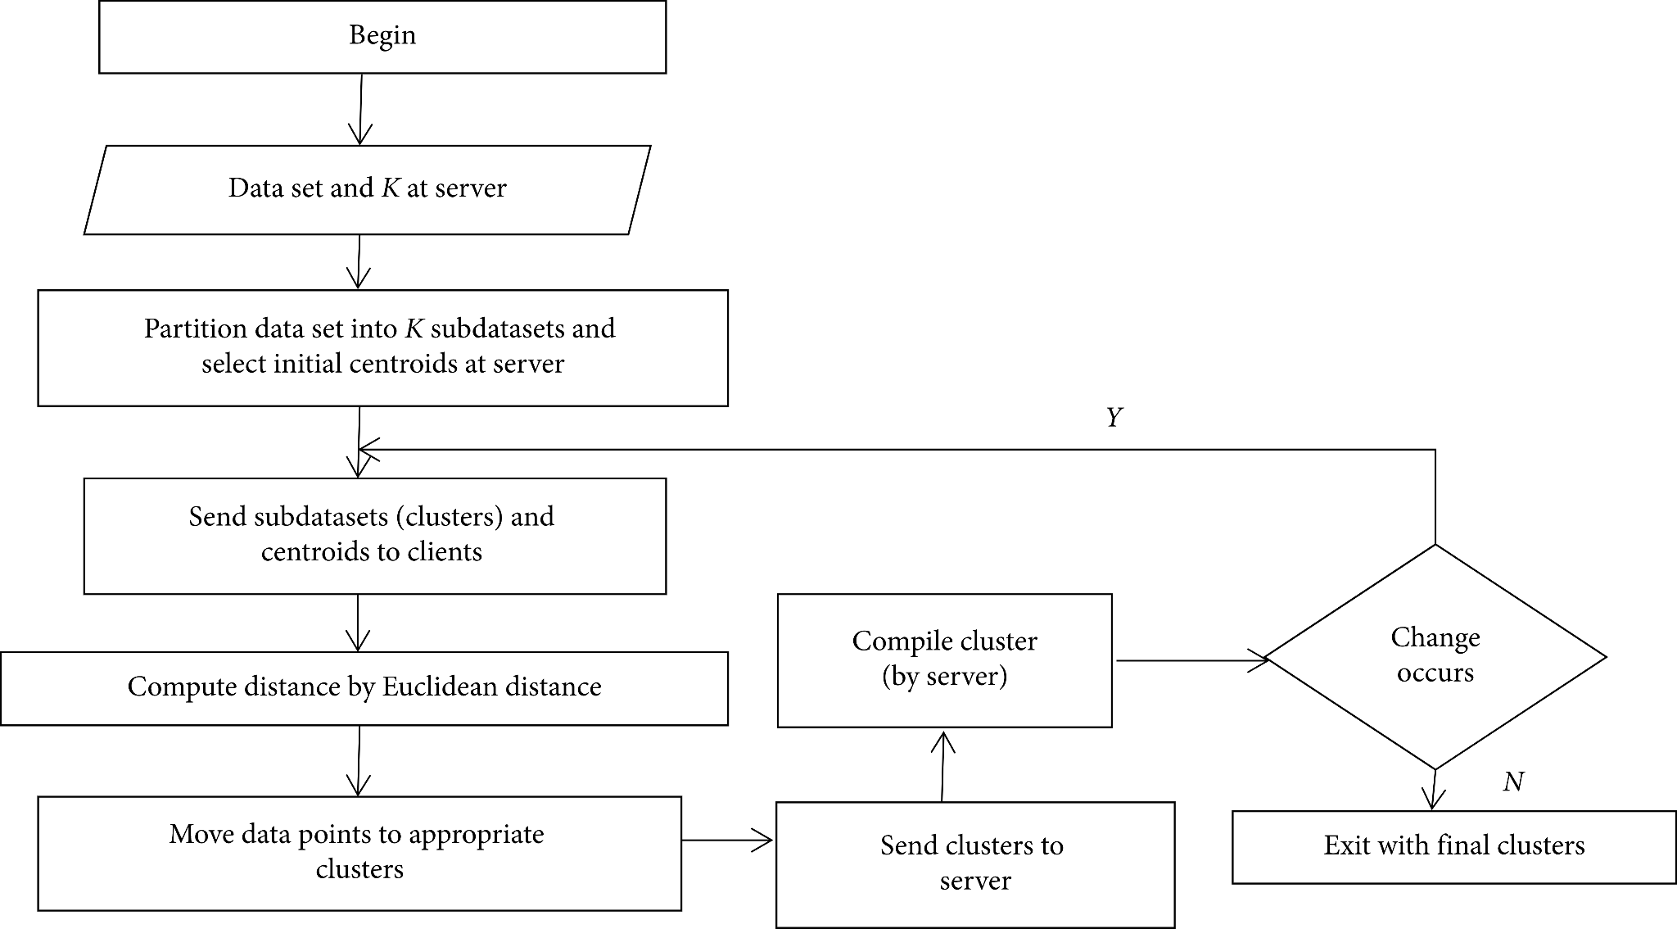
Flow chart of Parallel K-Mean clustering algorithm

Slide 9
4. Results

Slide 10
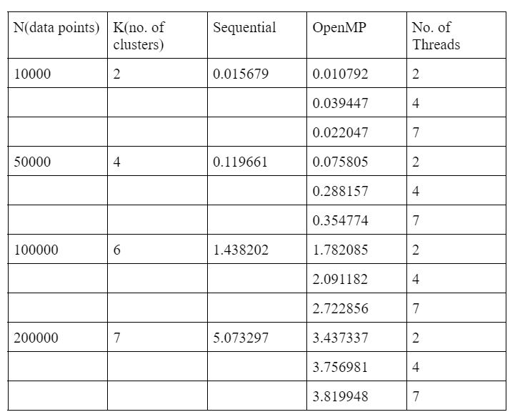
Readings of time taken:.

Slide 11
Thanks!

